Slide 1

The Ongoing Work for a Technical Vocabulary of DDI and SDMX Terms
Marco Pellegrino
Eurostat
Background
Work Products
Inputs to the Joint Vocabulary
The Challenge
Current Status
Looking Forward

Slide 2
Background
At the EDDI 2010 conference, an informal dialogue between SDMX, the DDI Alliance and interested members of the community was held
4 other meetings since then, and some telephone conferences
No formal membership: secretariat provided by UN/ECE (more than 40 people on the mailing list)
Goal of this work: to help the standards bodies coordinate to better serve their users

Slide 3
Background (Continued)
Several areas of work: the different terminology between the SDMX and DDI communities was identified as one of the problems in the dialogue
A joint SDMX-DDI Vocabulary is being created to help address this issue
All relevant documents and information for the SDMX-DDI Dialogue can be found at http://www1.unece.org/stat/platform/display/metis/SDMX+DDI+Dialogue+-+Overview+Page

Slide 4
Work Products
So far, a small number of work products have been identified:
  Joint SDMX-DDI Vocabulary
  Business Case for using SDMX and DDI
  A proposed coordinated approach for using the standards in an interoperable way (register data use case)
Other documents are envisaged:
  DDI, SDMX and the GSBPM to support statistical quality improvements
  Detailed examples
Each of the work products is being created by a small team of volunteers from the SDMX and DDI communities

Slide 5
Work Products (Continued)
The team working on the initial drafting of the Joint SDMX-DDI Vocabulary includes:
  Marco Pellegrino (Eurostat)
  Arofan Gregory (Open Data Foundation)
  Chris Nelson (Metadata Technology)
  Mary Vardigan (DDI Alliance)
  Joachim Wackerow (GESIS/DDI Alliance)
We anticipate many more participants as we get further along in the process, especially in a review capacity

Slide 6
The terminology challenge
  Definitions and descriptions are often insufficient to support a correct use of a standard
  Names are often not definitive for concepts
  Standardization must focus on definitions rather than names

Slide 7
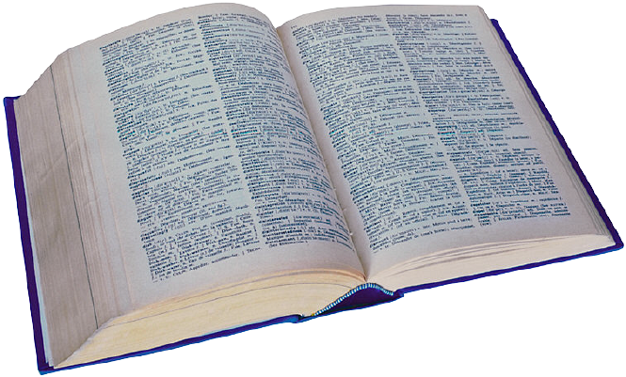
ISO/IEC 11179 Part 4:
Rules and Guidelines for the Formulation of Data Definitions
The purpose of a data element definition is to define a data element with words or phrases that describe, explain, or make definite and clear its meaning
Good definitions promote the standardization and reuse of data elements, leading to data sharing and integration of information systems

Slide 8
Data Definition Rules
A data definition shall be:
  Unique
  Singular
  A statement of concept, not its negative
  A descriptive phrase or sentence
  Commonly understood abbreviations
  Without embedded definitions

Slide 9
Data Definition Guidelines
  State the essential meaning of the concept
  Be precise and unambiguous
  Be concise
  Be able to stand alone
  Be expressed without embedding rationale, functional usage, domain information or procedural information
  Avoid circular reasoning
  Use consistent terminology and structure for related definitions

Slide 10
Inputs to the Joint Vocabulary
The SDMX Secretariat has been working to develop a comprehensive SDMX Vocabulary for use within that community
  SDMX Metadata Common Vocabulary developed as part of the “Content-Oriented Guidelines” (2009)
  SDMX Technical Vocabulary based largely on the SDMX Information Model, with other inputs
Early draft of a DDI Vocabulary was developed by the DDI alliance for input into this process

Slide 11
The Challenge
Question: What is a Category Scheme?
Answer: That really depends (on which standard you are using…)
This is a simple example of how the same term is used to refer to two completely different types of metadata!
There are other, similar differences of terminology which could produce confusion.

Slide 12
SDMX: is everything well described?
Data
or Metadata Structure Definition
Structure and Item Scheme Maps
Category Scheme
Categorisation
Data Set or Metadata Set
Data or Metadata Flow
Category
Content
Constraint
Attachment
Constraint
Data Provider
Provision Agreement
Registered Data Source or Metadata Source
Notes:
Chris

Slide 13
using
Study
Survey
Instruments
measures
made up of
about
Concepts
Questions
Universes

Slide 14
DDI: everything clear?
Category Scheme
Code Scheme
Concept Scheme
Control Construct Scheme
GeographicStructureScheme
GeographicLocationScheme
InterviewerInstructionScheme
Question Scheme
NCubeScheme
Organization Scheme
Physical Structure Scheme
Record Layout Scheme
Universe Scheme
Variable Scheme
Dataset
Dcelements
DDI profile
Conceptual component
Study unit
Group
Resource package
Instance
Coverage
…
…
…

Slide 15
Technical Vocabulary: expected benefits
Support a common understanding of the agreed technical standards by providing a single authoritative list of the technical terms used in the standards, together with a description of each term and, if needed, some context explanations
Facilitate a comparison with other standards and a mapping of concepts with minimum need to determine “semantic equivalence”
Improve visibility for existing definitions (building on existing sources and avoiding a proliferation of “standard” terminologies)
Improve accessibility to a set of standard definitions through a single address
Notes:
8
Value added in terms of transparency and as a single record of definitions in various formats (doc, html, xml,…)
Criteria for inclusion/exclusion
Production of a consolidated version, following terminology standards
Update of definitions. Coordination between different sources (technical specifications, user guide, MCV)
Target audience
Rules for the maintenance, periodic revisions
Next step: DSTV (DDI + SDMX Technical Vocabulary) ?

Slide 16
Vocabulary STRUCTURE
Term (mandatory)
Definition (mandatory)
Definition source (mandatory)
Context (in SDMX and DDI)
Links to related terms within the glossary (optional)
URL to more detailed information (optional)
Several outputs (doc, html, xml)

Slide 17
Current Status
The terms in the SDMX Vocabulary are now being evaluated (TWG) so that an appropriate subset can be mapped to DDI
The first draft will not be comprehensive
  It will only address the main objects in each standard, and those which have very strong similarities between the two standards
The initial set of DDI terms, plus their relationship to SDMX objects, has been drafted
Notes:
Identifiable = has ID
Versionable = has ID, version
Maintainable = has ID, version, agency

Slide 18
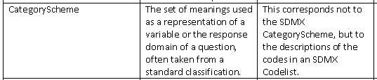

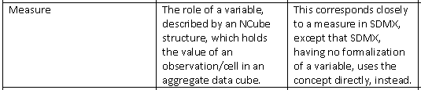
The Initial Draft DDI-SDMX Vocabulary
(example)

Slide 19
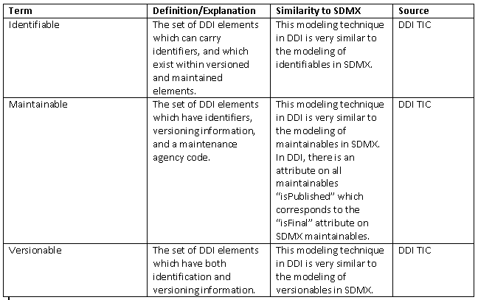
The Initial Draft DDI-SDMX Vocabulary
(example)

Slide 20
Looking Forward
We expect to have the initial draft ready for consideration by the larger group by march 2012
Hopefully, this document can be finalized and then expanded:
  We expect it to be a living document as the SDMX-DDI dialogue proceeds
  It will be published as a contribution to the integrated use of DDI and SDMX

Slide 21
Generic Process Example
DDI
Survey/Register
Anonymization, cleaning,
recoding, etc.
Tabulation, processing,
case selection, etc.
Indicators
Raw Data Set
Micro-Data Set/
Public Use Files
Aggregation,
harmonization
Aggregation,
harmonization
SDMX
Aggregate Data Set
(Higher Level)
Aggregate Data Set
(Lower level)

Slide 22
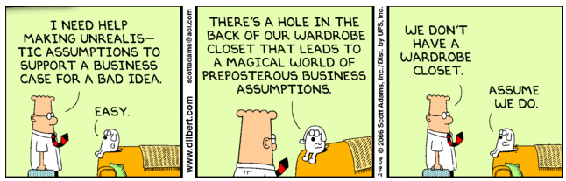
Business case: a key issue in the DDI-SDMX dialogue
Thank you!
marco.pellegrino@ec.europa.eu

